Slide 1

Computer Systems Forensic Analysis
AFSC
Introduction to digital forensics
Artur Varanda
School Year 2021-2022

Slide 2
CONCEPTS
Digital investigation focus:
digital devices that has been involved in an incident or crime
device used to:
commit a physical crime – e. g. a suspect used the Internet to conduct research about a physical crime
execute a digital event that violates a policy or law – e. g. an attacker gains unauthorized access to a computer, a user downloads contraband material, or a user sends a threatening e-mail, etc;
When the violation is detected, an investigation is started to answer:
what, who, when, how
in some cases “where” and “why”

Slide 3
CONCEPTS
A digital investigation is
a process where we develop and test hypotheses that answer questions about digital events
  a scientific method
  where we develop a hypothesis using evidence that we find
  and then test the hypothesis by looking for additional evidence that shows the hypothesis is impossible
Digital evidence
Is a digital object that contains reliable information that supports or refutes a hypothesis. The digital evidence must be:
admissible, authentic, accurate and complete

Slide 4
CONCEPTS
Digital evidence is:
information stored or transmitted in digital formats or media, the content of which is evidence, whether material or merely indicative, of a particular incident or event;
It is fragile and volatile, so the attention of a certified expert is required in order to ensure that the data of probative value are effectively isolated and extracted correctly and lawfully.
Digital evidence challenges:
hard to control – it is very easy to create, modify, transmit or delete data in short amount of time
diversity and complexity – some times is hard to identify the digital evidences because information systems evolve too fast

Slide 5
DIGITAL FORENSIC
Forensic means
it has legal requirements to be accepted into a court of law
Note:
A digital forensic investigation is a more restricted form of digital investigation

Slide 6
DIGITAL FORENSIC
Definition by Brian Carrier
Process that uses science and technology to analyze digital objects and that develops and tests theories, which can be entered into a court of law, to answer questions about events that occurred.
Another definition
The systematic and technological inspection of a computer system and its contents in order to obtain evidence of a crime or any other use that is under investigation.

Slide 7
DIGITAL INVESTIGATION
Types of analysis to find evidences:
live analysis – when the operating system or other resources of the system being investigated is used to find evidence
advantages: get data from RAM of a running process
disadvantages: risk of getting false information because the software could maliciously hide or falsify data
post-mortem analysis – when trusted applications in a trusted operating system are used to find evidence (lab environment)
advantages: fully controlled environment
disadvantages: information from RAM is lost, e. g. key to decrypt a file, ...
A post-mortem analysis is more ideal, but not always possible.

Slide 8
EXAMPLE OF DIGITAL INVESTIGATION
A server has been compromised, how it occurred and who did it?
  find data that were created by events related to the incident recover deleted log entries from the server
  find attack tools
  find the vulnerabilities that existed on the server
  using this data, and more, we develop an hypotheses
  which vulnerability the attacker used to gain access
  what he/she did afterwards
later, examine the firewall configuration and logs
  determine that some of the scenarios in our hypotheses are impossible because that type of network traffic could not have existed
  evidence was found that refutes one or more hypotheses

Slide 9
DIGITAL FORENSIC
Digital Crime Scene Investigation Methodology

Slide 10
DIGITAL FORENSIC
Investigation process
There is no single way to conduct an investigation
It does not matter which process is used,
As long as we find the right person and do not break any laws in the process
However, some are more efficient than others
The four major phases – based on the physical crime scene investigation process

Slide 11
PHASE 1 – IDENTIFY THE SOURCE OF THE DIGITAL EVIDENCE
1 – Preparation
physically identifying the origin of the digital evidence
choose the best approach to analyze it
equipment seizure

Slide 12
PHASE 2 – SYSTEM PRESERVATION
2 – System Preservation
goals
preserve the state of the digital crime scene
reduce the amount of evidence that may be lost
actions vary depending on the legal, business, or operational requirements of the investigation
legal requirements may cause you to unplug the system and make a full copy of all data or,
could be a case involving a spyware infection or a honeypot and no preservation is performed
if it’s not going to court, techniques in between can be used

Slide 13
PHASE 2 – SYSTEM PRESERVATION
Preservation Techniques
post-mortem analysis
pull the plug to reduce the amount of evidence that is overwritten
make duplicate copies of all data
use write blockers to prevent evidence from being overwritten
live analysis
kill or suspend suspect processes unplug or limit network connection
use an empty hub or switch to prevent log messages about a dead link
use network filters to avoid a remote connection from perpetrator to delete data
backup important data (logs, files, etc)

Slide 14
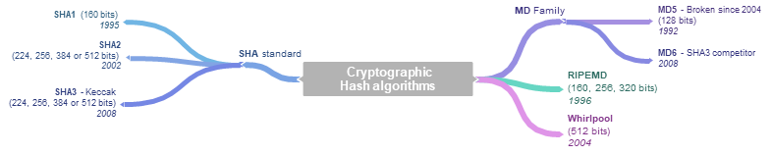
PHASE 2 – SYSTEM PRESERVATION
Data integrity
when important data are saved during a post-mortem or live analysis, a cryptographic hash should be calculated to later show that the data have not changed
Cryptographic hash algorithms

Slide 15
PHASE 2 – SYSTEM PRESERVATION
Data integrity – MD5 cryptographic hash
  this algorithm is broken since 2004
  use only for retro compatibility purposes
  it is possible to create collisions – different files with the same hash value examples:
http://www.mscs.dal.ca/~selinger/md5collision/
Demonstration

Slide 16
PHASE 2 – SYSTEM PRESERVATION
Data integrity – Hash values by itself are not enough
  given a message M, its hash value is H(M) = h
  someone can change both M and h, because h doesn’t depend on a secret
Possible solution:
Digital Signatures
depends on a private key
better if done with a secure device,
    e. g. the Portuguese Citizen Card (Cartão de Cidadão)

Slide 17
PHASE 3 – EVIDENCE SEARCHING
3 – Evidence searching
goal: find data that support or refute hypotheses about an incident
typically starts with a survey of common locations based on the type of incident:
  Web-browsing habits: look at the Web browser cache, history file, and bookmarks
  Linux intrusion: look for signs of a rootkit or new user accounts
It is important to look also for evidence that refutes your hypothesis instead of only looking for evidence that only supports your hypothesis.

Slide 18
PHASE 3 – EVIDENCE SEARCHING
The searching process:
define the general characteristics of the object for which we are searching
look for that object in a collection of data
two key steps:
  determining for what we are looking
  where we expect to find it
Example:
search all files with pictures

Slide 19
PHASE 3 – EVIDENCE SEARCHING
Search techniques:
most searching for evidence is done in a file system and inside files
search for files based on:
their names, or patterns in their names
a keyword in their content
temporal data, such as the last accessed or written time
hash values and compare them against a database
  allows to find all files of a given type even if someone has changed their name
  National Software Reference Library (NSRL) database http://www.nsrl.nist.gov
analyzing network data based on:
packet headers, such as IP addresses, port number, protocol, . . .
keywords inside packets content

Slide 20
PHASE 4 – EVENT RECONSTRUCTION
4 – Event reconstruction and report
goal: try to answer questions about digital events in the system
during the Evidence Searching Phase we might find several files that violate a law
  but it doesn’t answer questions about events
  the file may have been the effect of an event, but what application downloaded it?
  a web browser?
  a malicious software? — several cases have used malware as a defense
it may be possible to correlate the digital events with physical events

Slide 21
PHASE 4 – EVENT RECONSTRUCTION
Event reconstruction requires knowledge about the applications and the OS that are installed on the system so that you can create hypotheses based on their capabilities
Examples:
different versions of Windows OS (XP, 7, 8, 10) can cause different events
different versions of Firefox, or Chrome Web browsers can cause different events

Slide 22
Exercises

Slide 23
EXERCISES – DATA INTEGRITY
Automate comparison of hash values
1. calculate the SHA256 values of all files inside a directory, e. g. C:\Windows or /etc and store the result in a file:
sha256sum * > SHA256.txt # works on Linux
2. verify the values:
sha256sum -c SHA256.txt # works on Linux
Tip for Windows OS:
hash calculation tool https://www.slavasoft.com/hashcalc/
Crack hash values
1. calculate the SHA256 of a common word, e. g. Baltazar:
echo-n "Baltazar"| sha256sum # this is a Linux command
2. copy the hash value and paste it to crackstation.net or hashes.com
was the site able to find your word?

Slide 24
DIGITAL FORENSIC
Digital Evidence Handling

Slide 25
PRINCIPLES OF DIGITAL EVIDENCE HANDLING
Principles By EU-OLAF recomendation
The actions triggered by the first responders should not alter the data maintained on a computer or in a storage device that may be submitted to a court as evidence;
In exceptional circumstances, if it is considered necessary to access the original data stored on a computer or in a storage device, those who do so must have skills to be able to provide evidence, explaining the relevance and implications of his actions;
A chain of custody, or other record of all processes applied to digital evidence must be created and preserved. An independent third party should be able to examine these processes and obtain the same result;
The person responsible for the investigation must assume overall responsibility for compliance with the law and the present principles.

Slide 26
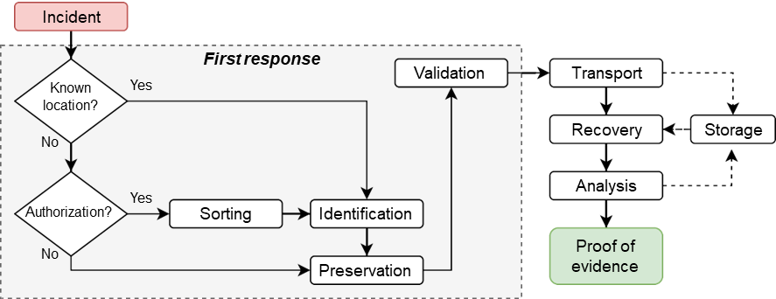
ROUTE OF THE DIGITAL EVIDENCE

Slide 27
DIGITAL EVIDENCE HANDLING GUIDELINES
1 – Identification
Data states
stored – data permanently stored in a storage device, e. g. an hard drive;
in transit – data being sent through a local network, or Internet, to a reception device;
in reception – data being received in a device, but not yet available to the user;
in creation – data being locally produced and only partially available to the user;
Data sources
storage devices – hard drives, SSD, USB drive, tapes, . . .
temporary location – RAM, page files, swap partitions, cache files, . . .
peripheral devices – printers, plotters, memory card readers, . . .
active network devices – switches, routers, modems, print servers, . . .

Slide 28
DIGITAL EVIDENCE HANDLING GUIDELINES
1 – Identification
logical and physical location of the data
local or remote devices
dedicated storage systems (usually on data centers)
computational systems (e. g. PC, laptop) has at least one storage device
main data types
simple and human readable, e. g. photos, text documents, spread sheets
complex and/or structured data, e. g. data bases, file system
raw data, streams of data

Slide 29
DIGITAL EVIDENCE HANDLING GUIDELINES
2 – Preservation
do not modify any data that could have been evidence
Copy important data, put the original in a safe place, and analyze the copy so that you can restore the original if the data is modified;
Calculate hash values of important data so that you can later prove that the data has not changed – better yet if you do a digital signature;
Use a write-blocking device during procedures that could write to the suspect data;
Minimize the number of files created during a live analysis because they could overwrite evidence in unallocated space;
Be careful when opening files on a live analysis because you could be modifying data, such as the last access time;

Slide 30
DIGITAL EVIDENCE HANDLING GUIDELINES
2 – Preservation: Prioritize the evidence to be collected
Order of volatility:
  CPU, cache, and register content;
  routing table, ARP cache, process table, kernel statistics
  RAM
  temporary file system, swap space
  data on local storage media
  remotely logged data
  data contained on archival media (backups)

Slide 31
DIGITAL EVIDENCE HANDLING GUIDELINES
2 – Preservation: Sorting
Some times it is not possible to bring all devices due to several constrains: legal, time, technically unfeasible, . . .
Data sorting
In those situations a pre-analysis is required, but can only be performed if authorized accordingly to the country’s laws.

Slide 32
DIGITAL EVIDENCE HANDLING GUIDELINES
3 – Isolate
isolate yourself from the suspect data because you do not know what it might do
an executable from the suspect system could delete all files on your computer, or it could communicate with a remote system;
opening an HTML file from the suspect system could cause your Web browser to execute scripts and download files from a remote server;
Create an isolated environment
use virtual machines (VMware, VirtualBox, Xen, . . . )
use an analysis network that is not connected to the outside world, or that is connected using a firewall that allows only limited connectivity
isolation is very difficult, or impossible, with live analysis

Slide 33
DIGITAL EVIDENCE HANDLING GUIDELINES
4 – Correlate
correlate data with other independent sources
helps reduce the risk of forged data
timestamps can be easily changed in most systems
find log entries, network traffic, or other events that can confirm the file activity times
This task is time consuming, specially if done without the help of software

Slide 34
DIGITAL EVIDENCE HANDLING GUIDELINES
5 – Log
log and document all of your actions
helps identify what you have already done and what your results
helps identify what searches you have not done yet
in a live analysis, or performing techniques that will modify data, it is important to document what you do so that you can later document what changes in the system were made because of your actions

Slide 35

DIGITAL EVIDENCE HANDLING GUIDELINES
5 – Log: Identify devices:
create tags to uniquely identify devices e. g. PC01, PC01.1, PC01.2, . . .
take photographs
  after placing tags
  should be easy to read any relevant information, if needed take an overview photo and then a close up shot
    computer brand, model, serial number, . . .
    network cable connections, etc
Examples
Are there any problems with these photos?

Slide 36
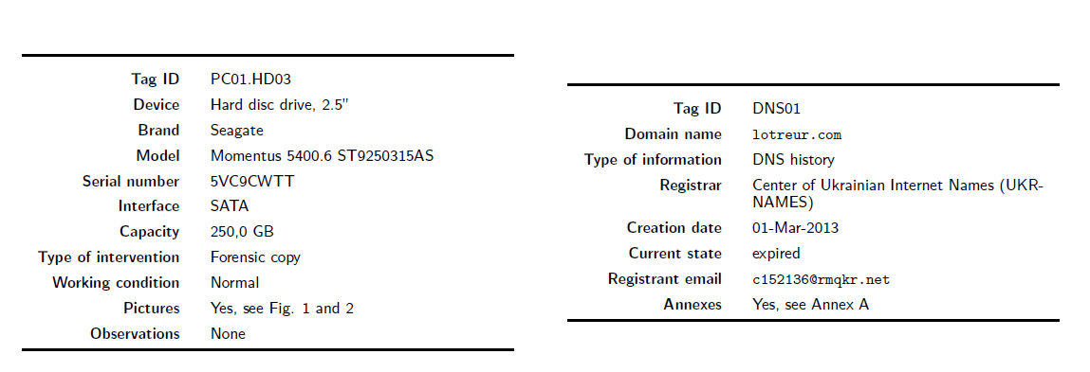
DIGITAL EVIDENCE HANDLING GUIDELINES
5 – Log: Templates
Create templates with the required info to identify devices and services

Slide 37
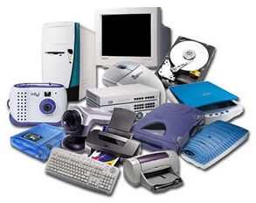
DIGITAL EVIDENCE HANDLING GUIDELINES
5 – Log: Reception and tagging
verify the list of devices delivered for analysis
tag the devices, taking into account that one process may have:
one suspect with several devices,
or several suspects and many devices
there are processes with 30+ suspects and 200+ devices!

Slide 38
DIGITAL EVIDENCE HANDLING GUIDELINES
5 – Log: Tagging rules (as an example)
letters to identify the owners of the devices in a given process
A, B, C, ...
set of acronyms for each device type, followed by a 2 digits number
FPHxx, SPHxx, SIMxx, MCxx, GPSxx, CAMxx, PCxx, LAPxx, HDDxx, SSDxx, PENxx, ...
a tag is composed by
ownerID.deviceID[.inside deviceID]
example of a samartphone with 2 SIM cards and a memory card:
  A.SPH01 – the handset from owner A
  A.SPH01.SIM01 – first SIM card
  A.SPH01.SIM02 – second SIM card
  A.SPH01.MC01 – memory card

Slide 39
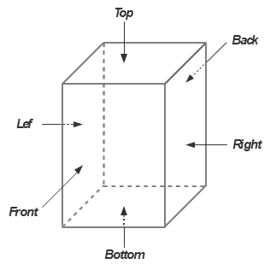
DIGITAL EVIDENCE HANDLING GUIDELINES
5 – Log: photograph rules (as an example)
include the scale of a ruler in the photo
photograph all important views
there are mandatory views by device type and some optional
attention to details, like serial numbers, IMEI, etc
apply the views names accordingly to the 3D box
position of the device is important
for some devices might be ambiguous which is the front, e. g. SIM card
photos filenames: tagID-view name[-detail].jpg
examples:
A.SPH01-front.jpg,
A.SPH01-back-serial.jpg,
A.SPH01.MC01-front.jpg,

Slide 40
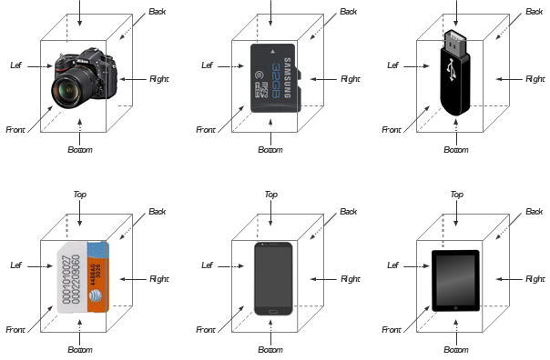
DIGITAL EVIDENCE HANDLING GUIDELINES

Slide 41
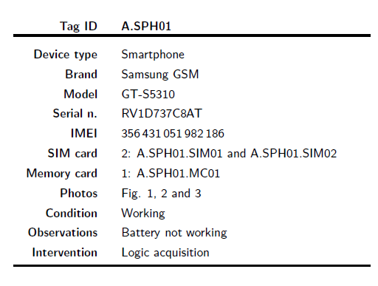
DIGITAL EVIDENCE HANDLING GUIDELINES
5 – Log: Catalog the device to uniquely identify it,
e. g.:
tag ID device type
brand and model number
serial number, IMEI, UICCID, . . .
type of intervention (logical or physical acquisition)
device’s condition (working / non-working)
contents, e. g. has SIM or memory card
worthy observations
etc

Slide 42
Digital Forensic
ETHICAL CODE

Slide 43
ETHICAL CODE
Intent of the Ethical Code
necessary to protect the integrity of the digital investigation process
there are several codes
  Example: International Society of Forensic Computer Examiners (ISFCE)
  https://www.isfce.com/ethics2.htm

Slide 44
INTERNATIONAL SOCIETY OF FORENSIC COMPUTER EXAMINERS
A computer examiner will always:
Demonstrate commitment and diligence in performance of assigned duties
Demonstrate integrity in completing professional assignments
Maintain the utmost objectivity in all forensic examinations and accurately present findings
Conduct examinations based on established, validated procedures
Abide by the highest moral and ethical standards and abide by this Code
Testify truthfully in all matters before any board, court or proceeding
Avoid any action that would knowingly present a conflict of interest
Comply with all legal orders of the courts
Thoroughly examine all evidence within the scope of the engagement

Slide 45
INTERNATIONAL SOCIETY OF FORENSIC COMPUTER EXAMINERS
A computer Examiner will never:
Withhold any relevant evidence
Reveal any confidential matters or knowledge learned in an examination without an order from a court of competent jurisdiction or with the express permission of the client
Express an opinion on the guilt or innocence of any party
Engage in any unethical or illegal conduct
Knowingly undertake an assignment beyond his or her ability
Misrepresent education, training or credentials
Show bias or prejudice in findings or examinations
Exceed authorization in conducting examinations

Slide 46
DIGITAL FORENSICS
Exercises

Slide 47
DIGITAL FORENSICS - EXERCICE
Make a list of the information to be registered to uniquely identify these devices or services:
  memory cards, computers, hard drives, solid state drives, phones, smartphones, GPS devices, routers, switches, modems
  services: web, DNS, POP3, IMAP, SMTP, SSH
Create a tagging system
  easy to memorize, that reflects hierarchy if needed (1 PC with several hard drives)
    e. g. computer: PC01, HD inside computer: PC01.1, ...
Write your findings on a document
  create a table template for each device or service
  add real photos for the devices: use your phones, your own PCs, ... (don’t forget the ruler)
This information will be used for the report of the Team Project

Slide 48

ANY QUESTIONS?

Slide 49
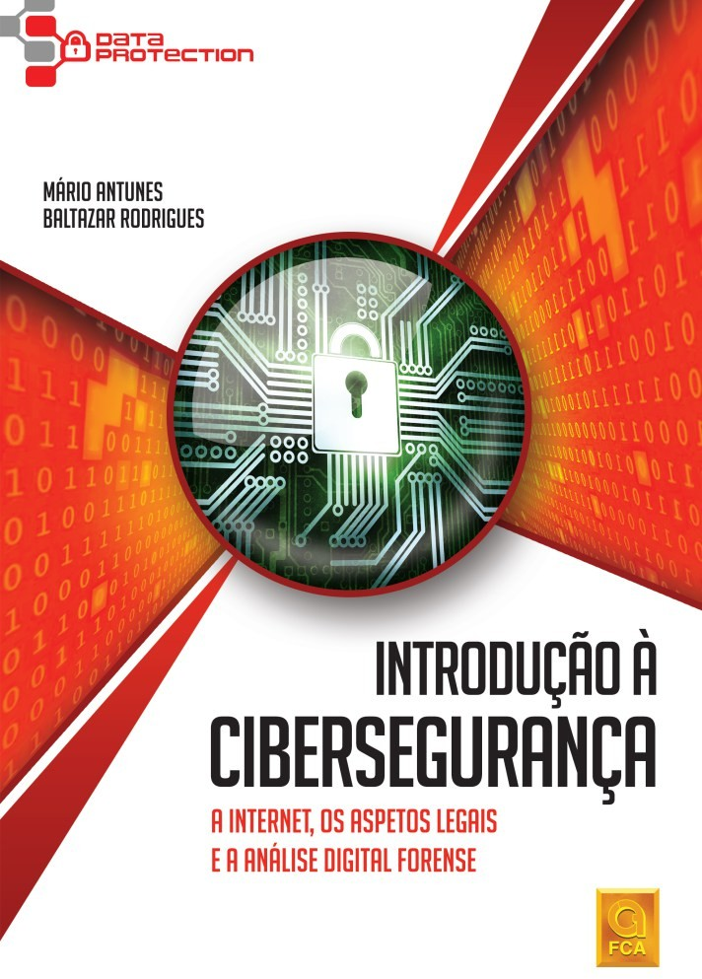
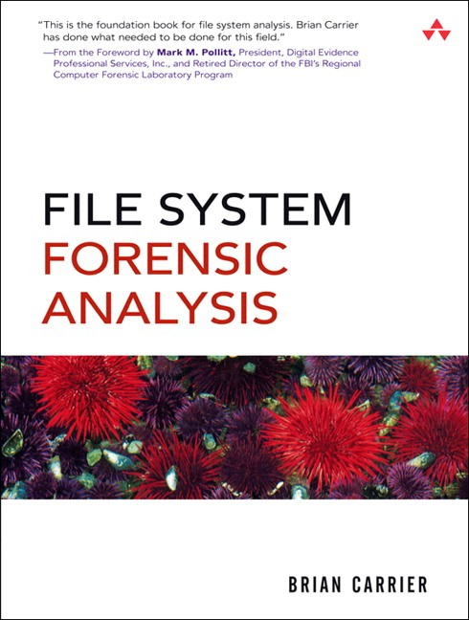
DIGITAL FORENSICS
Antunes, M. & Rodrigues, B. (2018) Introdução à Cibersegurança: A Internet, os Aspetos Legais e a Análise Digital Forense. FCA (ISBN-13: 978-9727228614)
Carrier, B. (2005). File system forensic analysis.
Addison-Wesley Professional (ISBN-13: 978-0321268174)

